Slide 1


AMBEDKAR INSTITUTE OF TECHNOLOGY,
NEW DELHI-110092
MAIN PROJECT BASED ON MATRIMONIAL WEBSITE USING WITH HTML, CSS, PHP
Submitted For The
Partial Fulfillment Of
Diploma
In
Computer Science Engineering
Presented By :
Guided By :
Name: Mukul Goyal
Roll No. 1902051046
Mr. J.P Soja sir

Slide 2
Content
Introduction
objective
Purpose Project
Scope of Project
Software requirements
Hardware requirements
Draw the design
Preview of Website
Conclusion
Future summary

Slide 3
INTRODUCTION
Our purpose is to provide legal help to everyone in all the legal fields, this website protect the privacy of client according to Indian rules, regulation and Indian law. The purpose of creating my matrimonial and legal works website is only so that the youngster can connect to us correctly, quickly and easily so that we can guide him in the right way.
In this website having many profile of advocates according to your case choose the profile and you can hire the advocate.

Slide 4
OBJECTIVE
It My Objective Is The New Generation To Provide Easy And Fast “ Matrimonial Legal Services”. Through The Our Matrimonial Website.

Slide 5
Purpose of Project
Its website purpose of creating my matrimonial and legal works website is only so that the people can connect to us correctly, quickly and easily so that we can guide him in the right way.
The information about the Firm is provided to the user only at the user’s specific request and any transmission, receipt or use of this website will not create any lawyer-client relationship. The Firm hereby disclaims any and all liability to any person for any loss or damage caused by errors or omissions, whether such errors or omissions result from negligence, accident or any other cause.
In this website having many profile of advocates according to your case choose the profile and you can hire the advocate.

Slide 6
Scope of Project
As we all very well known by the fact that the crime rate in the society is increasing at a rapid rate, hence the requirement for legal help is also increasing. The website like this help in providing the legal help one is seeking for Some time it is not possible for people to find someone to get help in legal matter but my project can help them as they can contact us from anywhere in the world.

Slide 7
Software Requirement
Software Requirement :-
Text Editor
Xampp with full setup
Xampp in phpmyadmin
Web Browser
like : - Chorme, Firefox, Safari

Slide 8
HADWARE REQUIRMENT
NO, SPECIAL HARDWARE REQUIREMENTS,
and website can be run any normal system
but system have a any web browser and internet connection, you can easily access the website.

Slide 9
Website Design
Logo
Main title
Login/singup
Navigation Bar
Image slider
content
Our services
Query form
footer

Slide 10
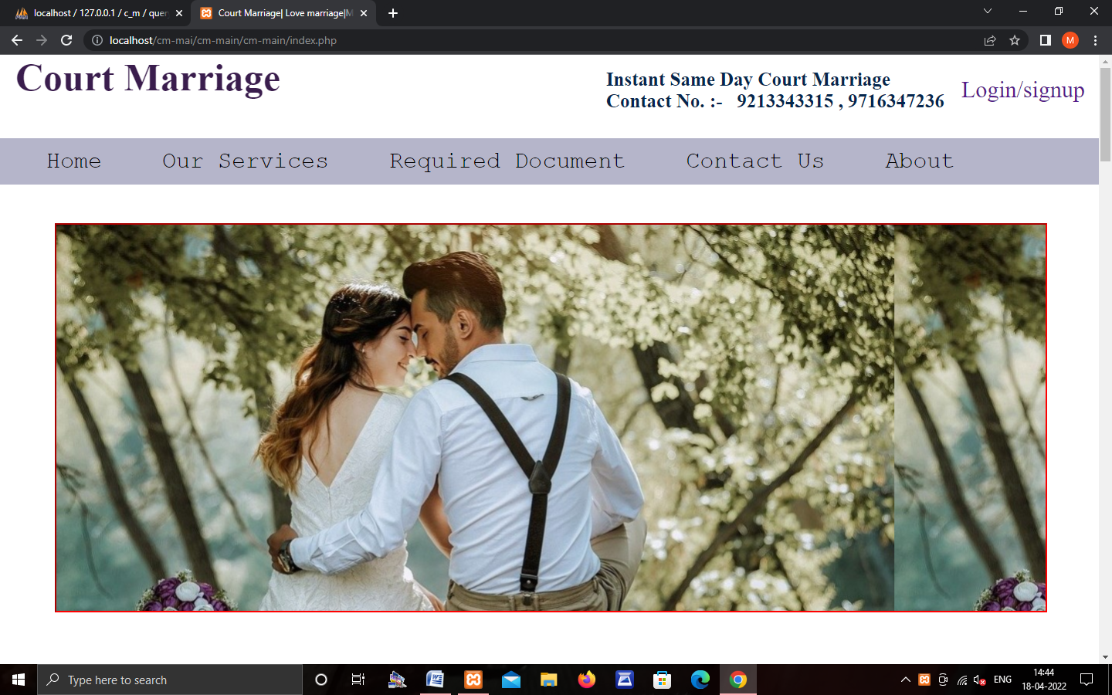
Preview of Website

Slide 11
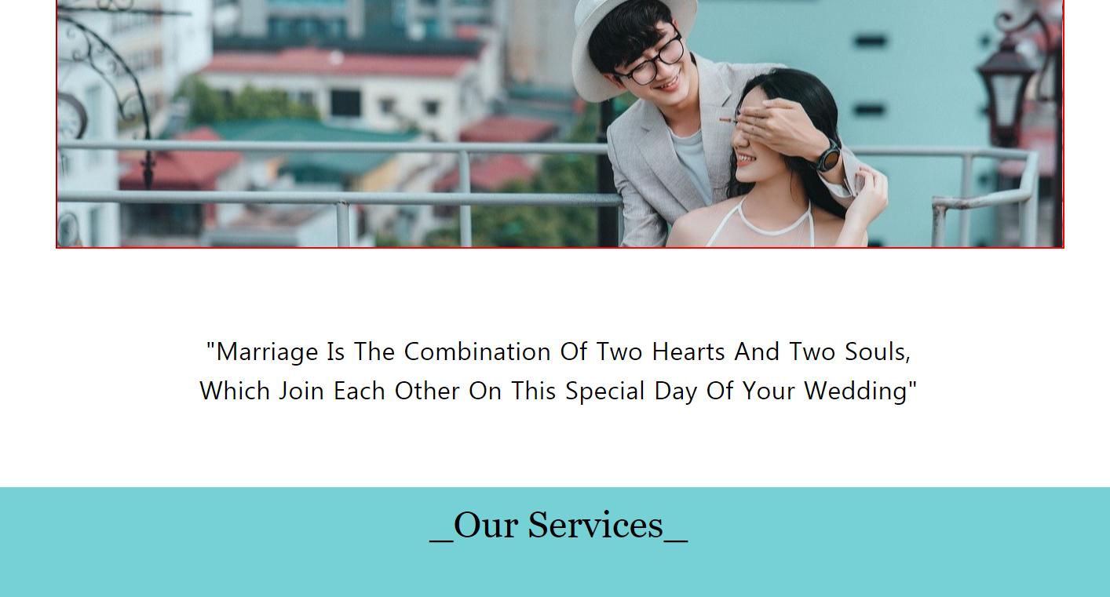

Slide 12
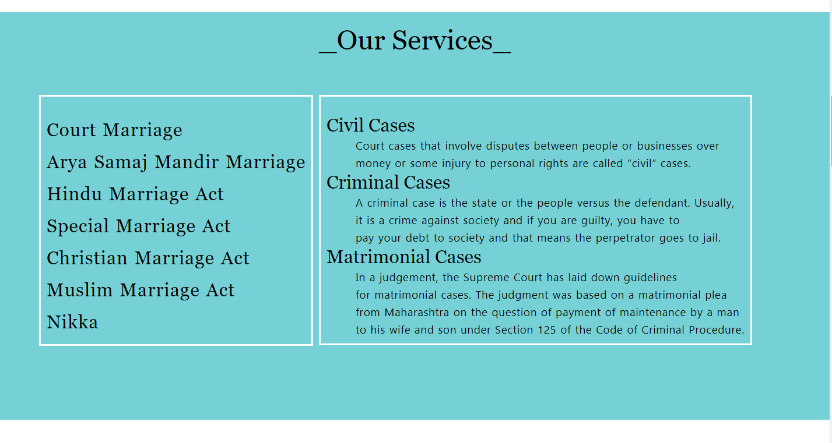

Slide 13
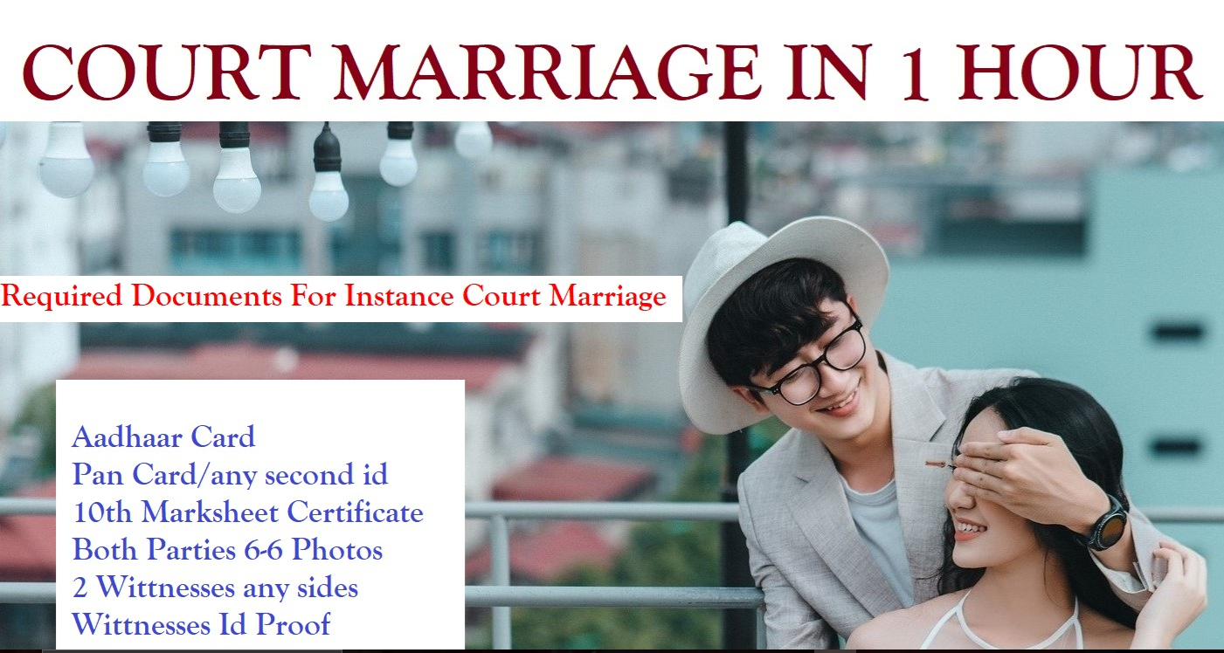

Slide 14
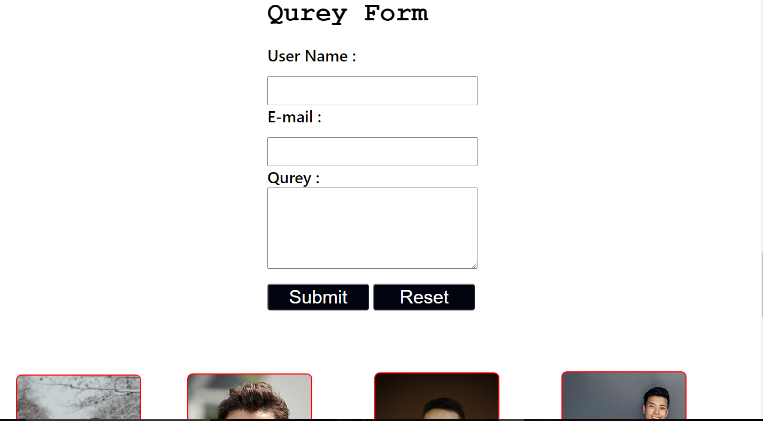

Slide 15
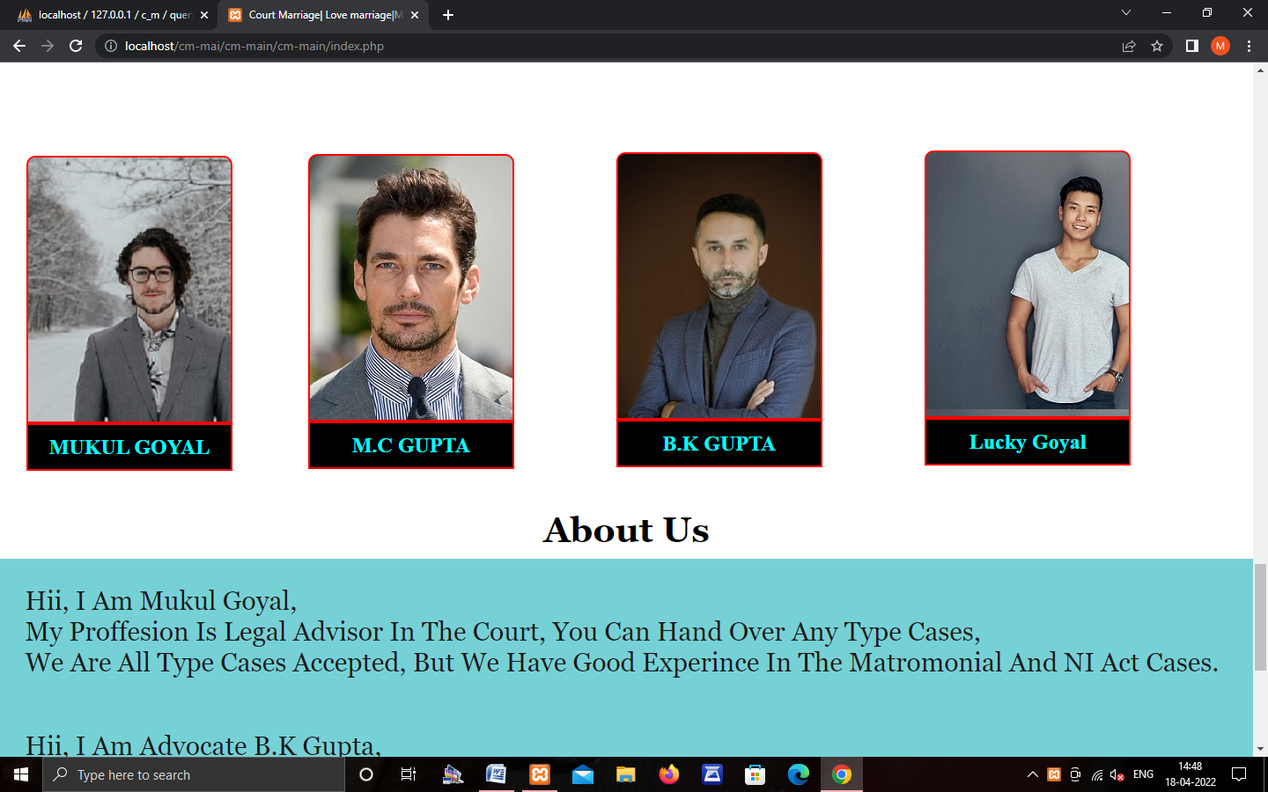
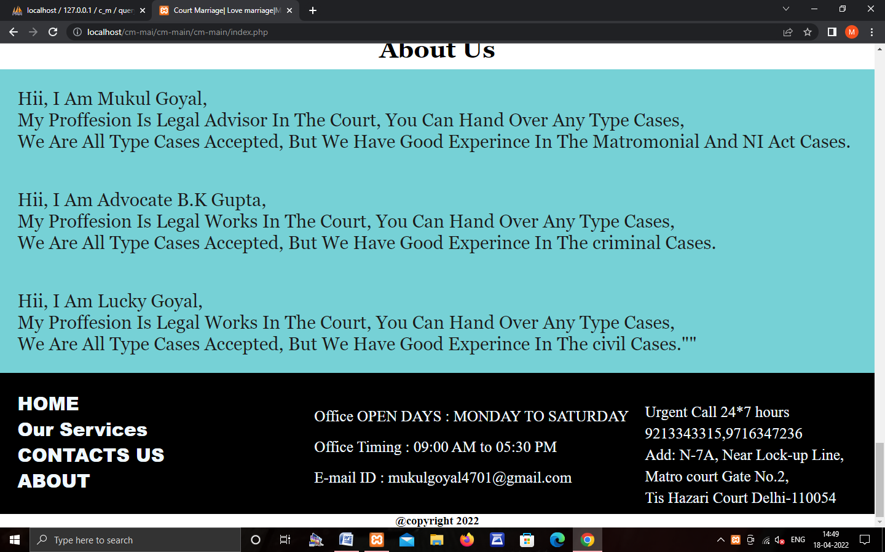

Slide 16
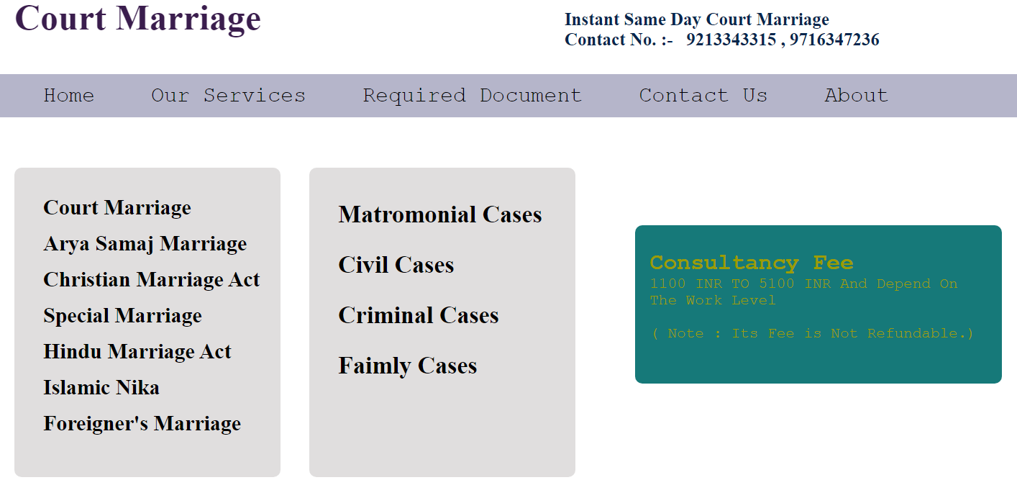

Slide 17
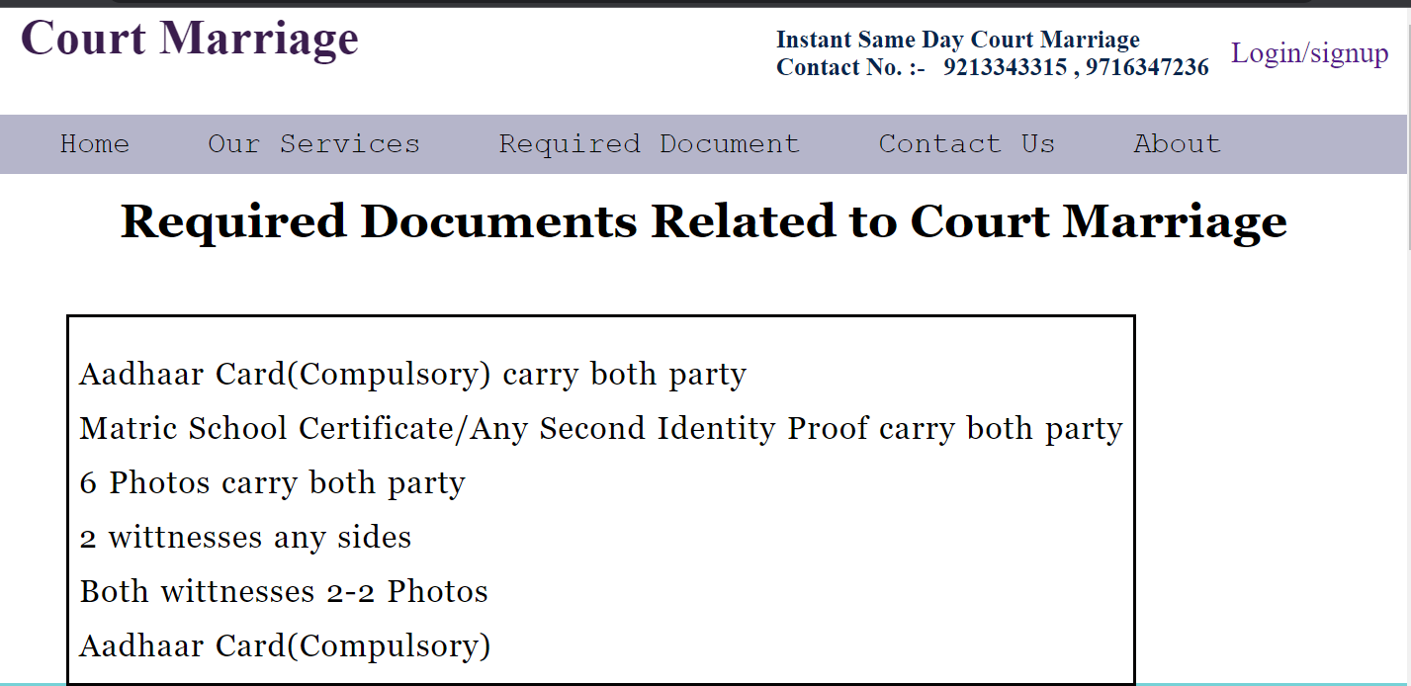

Slide 18
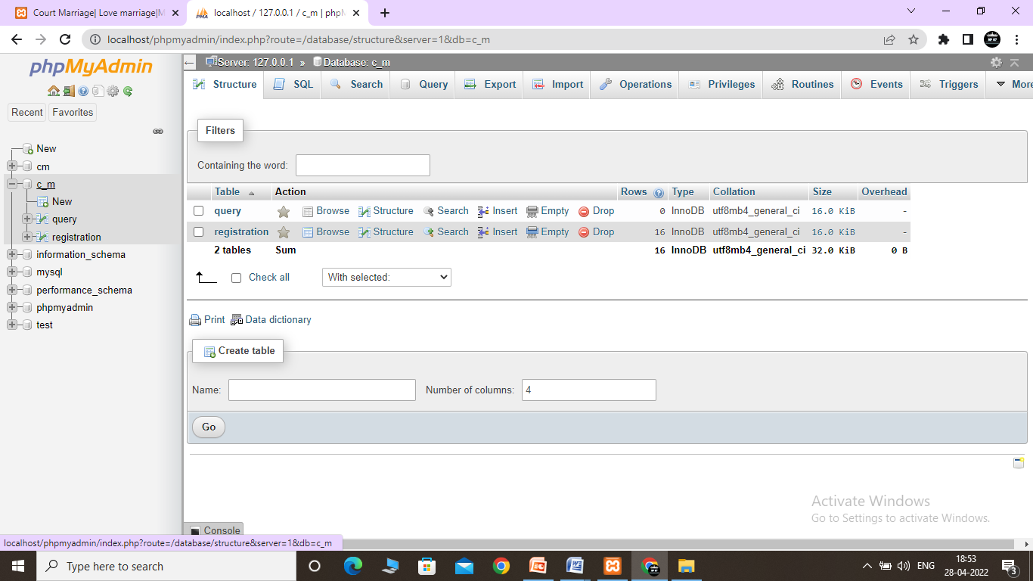
Backend Preview

Slide 19
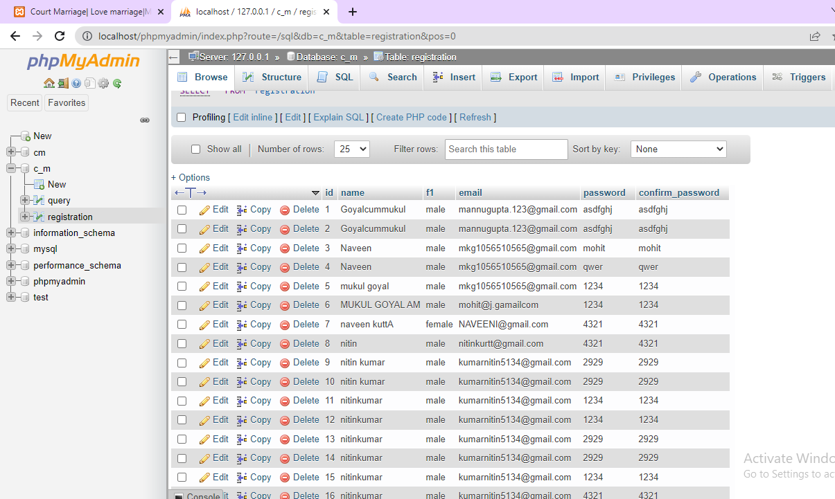

Slide 20
CONCLUSION
With website and the technology behind it there are many potential opportunities and capabilities. Website can open a whole new world of jobs, services, platforms, applications, and much more. There are thousands of possibilities beginning to form as the future of website starts to really take off.
For instance, client and service providers can get on website to develop new and different ways of selling their services to the website users through the website. It opens up a whole new platform for designers and web developers. Businesses and organizations can organize themselves and conduct business much more affordable and professionally. Social networking and keeping in touch with friends gets a great deal easier as well.

Slide 21
FUTURE SUMMERY
There we will hoping to insert javaScript also react.js and some of bootstraps For better performance of our website and also for our project.
So we will provide our best service to our customer
The arrival and wide acceptance of advanced technologies like react.js, and mangoDB more have made website portal a pivotal force in the digital transformation of various industries. Within a short period, website has become a priority of most organizations. The pandemic has further raised the demand because organizations of all sizes started adopting cultures like work from home, remote management, and more

